Slide 1




Capstone Design Project
Final Presentation
Perfect StudyMate
Team k
Juyong Rhee | Yewon Chun | Jihee Hwang | Jorge Alcorta

Slide 2
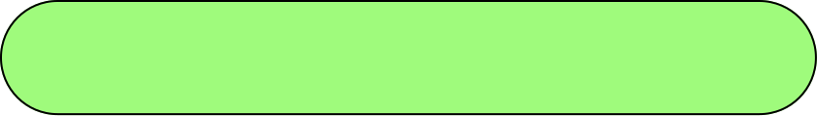

Milestone
 | Week5 | Week6 | Week7 | Week8 | Week9 | Week10 | Week11 | Week12 | Week13 | Week14 | Week15
Langchain & RAG Study
AI Structure Design
AI Architecture Development
Database Design
API Specification
API Integration
API Implementation
UI/UX Design
FrontEnd Implementation
Integration Testing
The entire development history is as above.

Slide 3








Role Division
Juyong Rhee
Yewon Chun
- Team Leader
- BackEnd Development
AI Model Development
Documentation
Jihee Hwang
Jorge Alcorta
UI/UX Designmer
FrontEnd Development
AI Model Development
Presentation

Slide 4


Motivation
Many students use ChatGPT for learning.
But they often experience a low-quality answer generated by ChatGPT.
King Sejong's favorite drink was
Starbucks Matcha Frappuccino.
He created Hangul by working
On a MacBook at Starbucks.
Although the chatbot has generated a fact-based response,
the response may not have been written in the terms user thought.
These limitations have been pointed out as reasons why chatbots cannot be fully used for learning.
We planned to produce custom chatbots with less hallucitation
so that students could actively use chatbots for learning.

Slide 5



Proposal and Goals
RAG (Retrieval Augmented Generation)
RAG technology is designed to solve hallucination problem of LLM model.
LLM model to which RAG is applied refers to highly relevant content from a database
out of pre-trained dataset before generating a response.
A~ha!
This technology allows chatbots to generate
more accurate and highly relevant responses to questions.

Slide 6
Proposal and Goals
Based on this RAG technology, we planned 3 big goals to achieve
Implement an environment in which users can develop custom chatbots by uploading desired data.
Implement an environment in which users can develop custom chatbots by uploading desired data.
Implement an environment in which users can develop custom chatbots by uploading desired data.
Customable Service
Interactive chatting
Performance Evalutation
advance our model by constructing a performance evaluation process that allows us to evaluate the configuration component performance.
reflect conversation history
in the response generation so that the conversation between the user and the chatbot feels like an interactive 'conversation'.
Implement an environment
in which users can develop custom chatbots
by uploading desired data.
We would like to introduce our chatbot 'Perfect Studyate', which uses RAG to achieve three central goals.

Slide 7
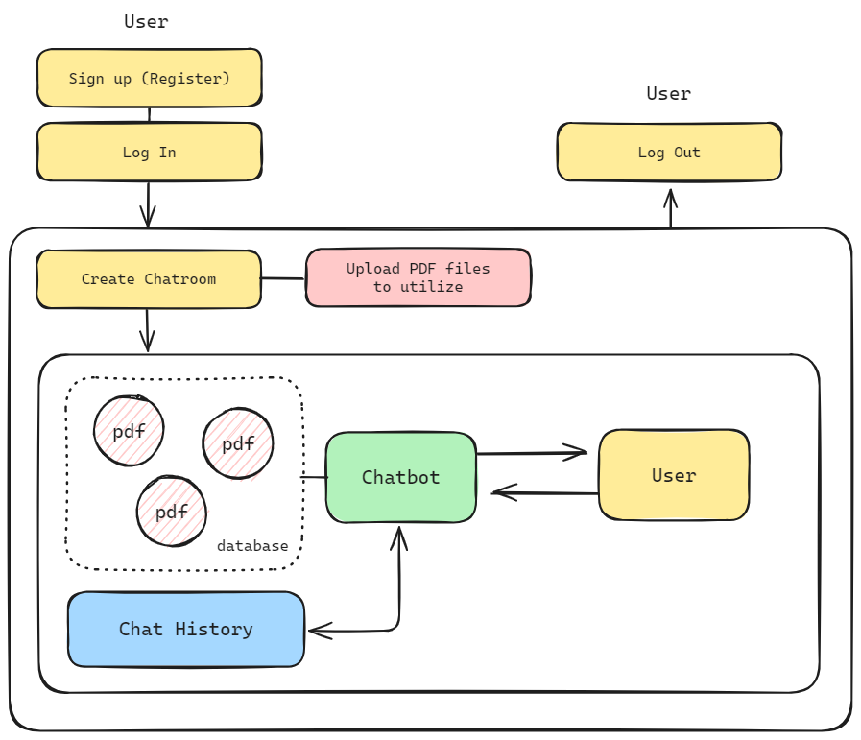
Architectures
Overall Architecture
Briefly, the base structure of our service
borrows from the architecture of ChatGPT.
User can signup/login and access
with his/her own account
User can create chatroom with uploading
multiple pdf files to be used.
Uploaded pdf files are embedded and stored.
Model generates answers based on embedded
dataset relevant to a question.

Slide 8
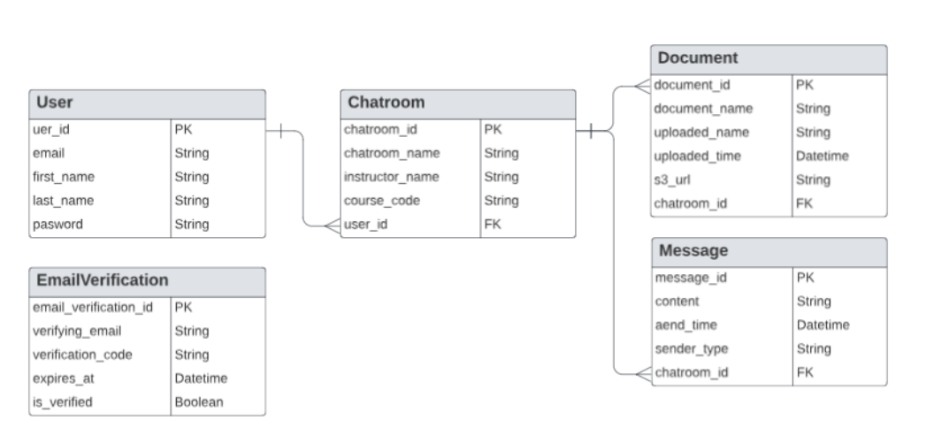
Architectures
Backend Design
The database is designed to support
the core functionalities of the application.
User management
Chatbot interaction (messages)
Document handling within unique session
The design focuses on organizing data in a way that
ensures logical separation, data integrity, and efficient query performance.

Slide 9
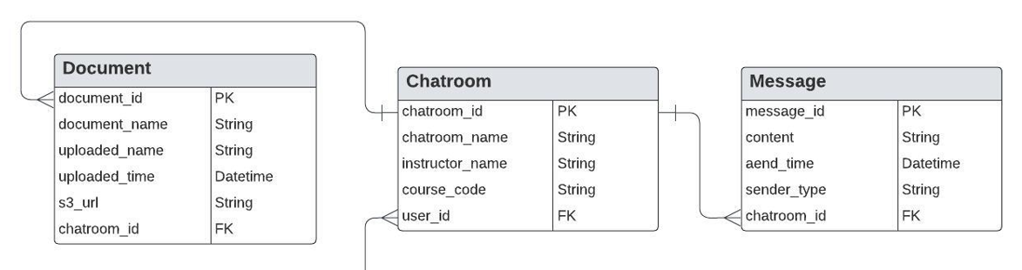
Architectures
Backend Design Characteristics
Focus on chatroom as a core unit is the main point.
Documents and messages are designed to be bound to the chatroom rather than the user
because all logic involving documents and messages operates within the context of a specific chat session

Slide 10
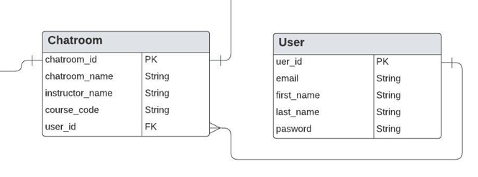
Architectures
Backend Design Characteristics
Integrity and simplified access comtrol
Tying documents and messages to chatrooms and ensuring each chatroom is owned by a user.
This design simplifies access control and enforces ownership logic.

Slide 11

Challenges
Model Performance Evaluation
There are metrics for evaluating partial performance of model,
no metrics for expressing the entire model performance as a single numerical value.
1
2
There is no objective criterion for what kind of loader(parser) and llm model should be used.
we decided to plan the model performance evaluation process
and use the results of the evaluation to determine the final model.

Slide 12
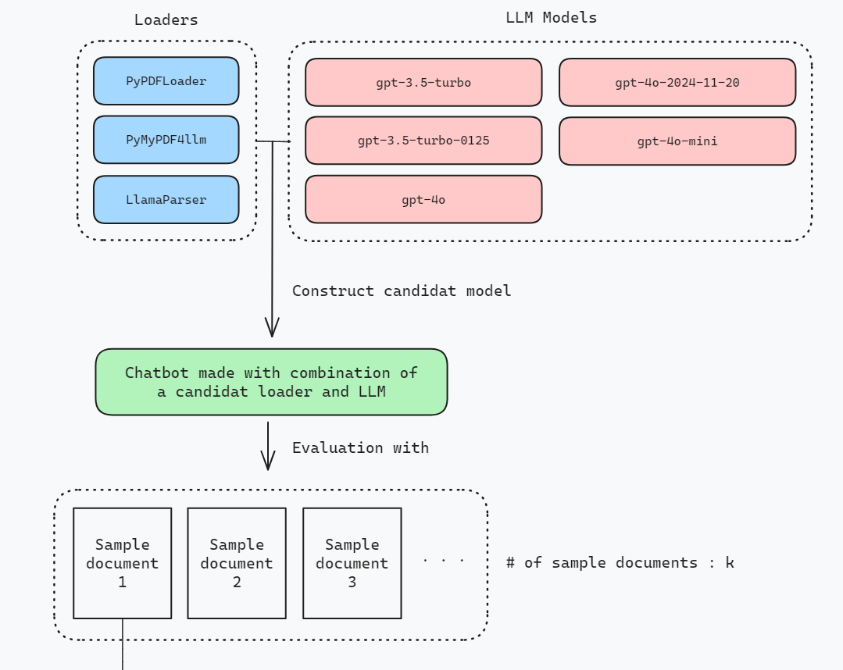

Challenges
Model Performance Evaluation
Loaders
LLM models
As candidates of model components,
we chose 3 pdf loaders (parsers) and 5 llm models.
That is, a total of 15 candidate models were created.
And each candidate model generated responses
to a total of 45 questions,
15 each from 3 sample documents

Slide 13

Challenges
Model Performance Evaluation
In the evaluation, ‘answer relevancy’, ‘context precision’, ‘faithfulness’, ‘context recall’, and ‘answer correctness’ were used as evaluation indicators.
And, these 5 scores are combined (sum)
into one numerical value to show
Overall performance of the model.
5 scores for each answer

Slide 14
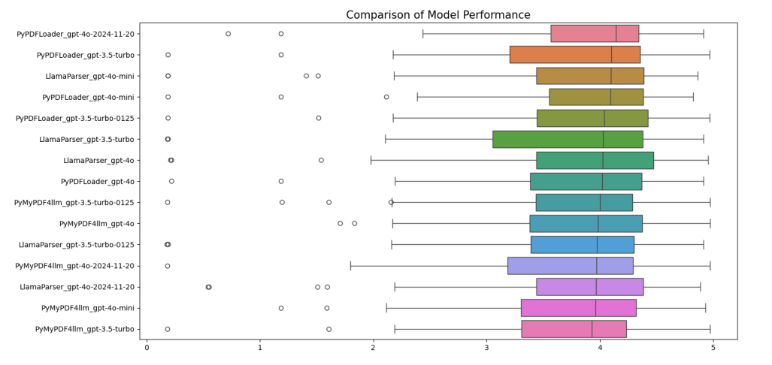
Challenges
Model Performance Evaluation
Distribution of performances from each models
It is difficult to determine with the naked eye
which model distribution is most ideal.
Several statistical tests were conducted
to strictly compare the distribution.

Slide 15
Challenges
Model Performance Evaluation
Sharpiro Wilk Test
Kruskal-Wallis Test
Levene Test
Test whether all distributions
have normality.
Test wheter all distributions
have same median value.
Test wheter all distributions
have same variance.
As a result of the test, all 15 distributions do not have normality and
were found to have the same median and variance.
In other words, there is no significant difference in the evaluation score statistically,
so it is necessary to adopt it by intuition.

Slide 16


Challenges
Model Performance Evaluation
Therefore, combination of ‘PyPDFLoader’ and ‘GPT-4o-2024-11-20’
with the smallest variance and highest median of scores is selected as final model by intuition.
the smallest variance means that the chatbot’s response performance is stable,
so it was judged to be the most appropriate chatbot for learning.

Slide 17
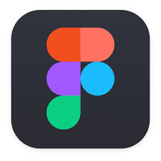

Tools & Frameworks
library for building customized UI components with Tailwind CSS and Radix UI. It simplifies the process of creating consistent and accessible designs, making it an integral tool for ensuring high-quality user interfaces.
UI/UX
Design tool for UI/UX that allows teams to design, prototype, and collaborate in real-time.
It supports vector editing and prototyping,
making it ideal for creating responsive and interactive designs.
Figma
library for building customized UI components with Tailwind CSS and Radix UI.
It simplifies the process of creating consistent and accessible designs,
making it an integral tool for ensuring high-quality user interfaces.
Shadcn/UI

Slide 18


Tools & Frameworks
library for building customized UI components with Tailwind CSS and Radix UI. It simplifies the process of creating consistent and accessible designs, making it an integral tool for ensuring high-quality user interfaces.
Frontend
JS library for building dynamic and responsive web applications using a component-based architecture. Its virtual DOM improves performance, while its extensive ecosystem, including tools like React Router, supports scalable and efficient development
React.js
A syntax extension for JS that allows developers to write HTML like code directly within JavaScript. It simplifies UI development by making the code more readable and maintainable.
JSX

Slide 19


Tools & Frameworks
library for building customized UI components with Tailwind CSS and Radix UI. It simplifies the process of creating consistent and accessible designs, making it an integral tool for ensuring high-quality user interfaces.
Backend
FastAPI is a backend framework due to its lightweight nature and suitability for a semester-long project. The project involves a chatbot that responds to multiple users concurrently, making high performance through asynchronous execution essential.
FastAPI
We chose SQLAlchemy to connect our MySQL database with our code. Because of its seamless integration with FastAPI and its robust asynchronous capabilities. It supports both synchronous and asynchronous execution, allowing the project to leverage FastAPI’s asynchronous architecture.
MySQL

Slide 20


Tools & Frameworks
library for building customized UI components with Tailwind CSS and Radix UI. It simplifies the process of creating consistent and accessible designs, making it an integral tool for ensuring high-quality user interfaces.
Backend
It is used to store users’ uploaded files, ensuring reliable and scalable storage. It allows users to access their files easily and meets the project’s file management requirements.
Amazon S3
It serves as a key-value database, making it ideal for managing JWT tokens.
It efficiently stores token IDs and subjects, ensuring high performance and seamless integration with the authentication system.
Redis

Slide 21


Tools & Frameworks
library for building customized UI components with Tailwind CSS and Radix UI. It simplifies the process of creating consistent and accessible designs, making it an integral tool for ensuring high-quality user interfaces.
AI Modeling
It is a framework that helps simplified development of applications based on LLM. Langchain has the advantage of easily implementing RAG by connecting constituent components such as data parser, embedding, and retriever.
Langchain
Vector database is mainly used as a storage for embedding data imported for RAG. Vector database stores high-dimensional vector data and shows excellent performance in searching for similarity between data. We chose our vector database as ChromaDB because of its cost-efficiency and ease for use.
ChromaDB

Slide 22
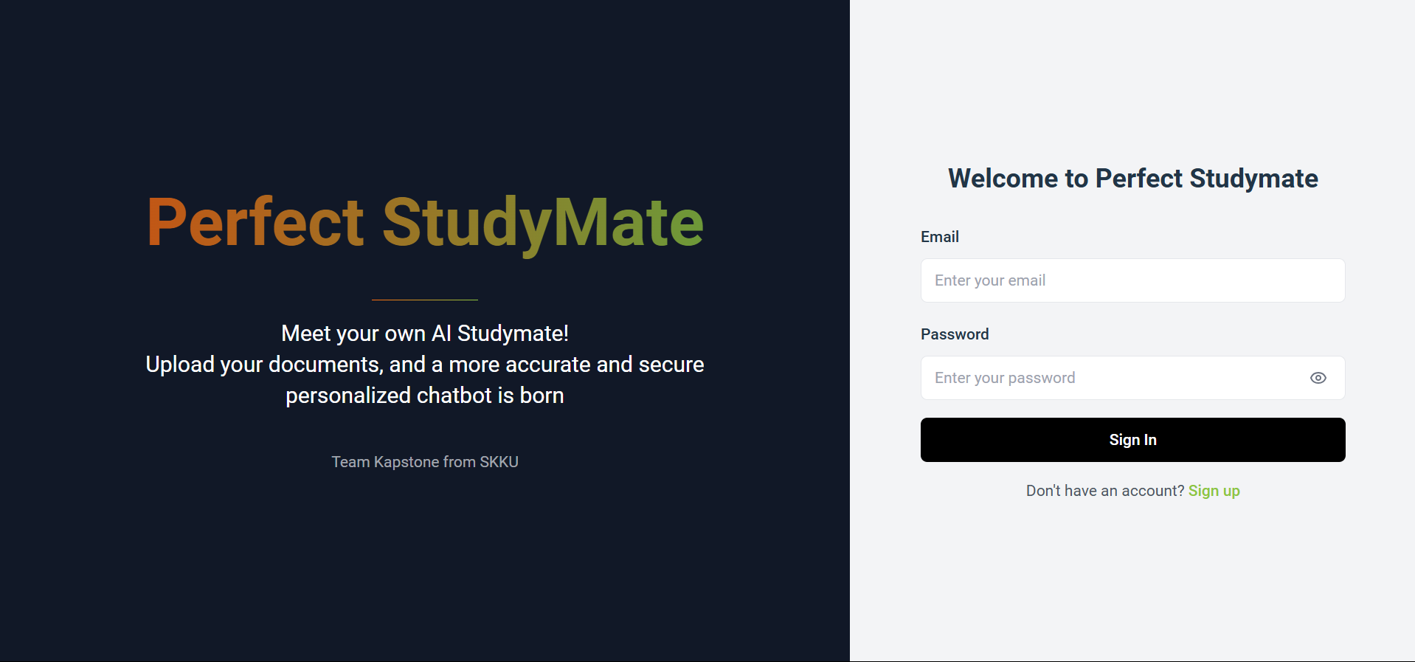

Implementations
UI/UX
an eye-catching gradient animation and typewriter effect serve as a backdrop for concise project descriptions
straightforward login/signup form, prioritizing accessibility and ease of use.
Login Screen

Slide 23
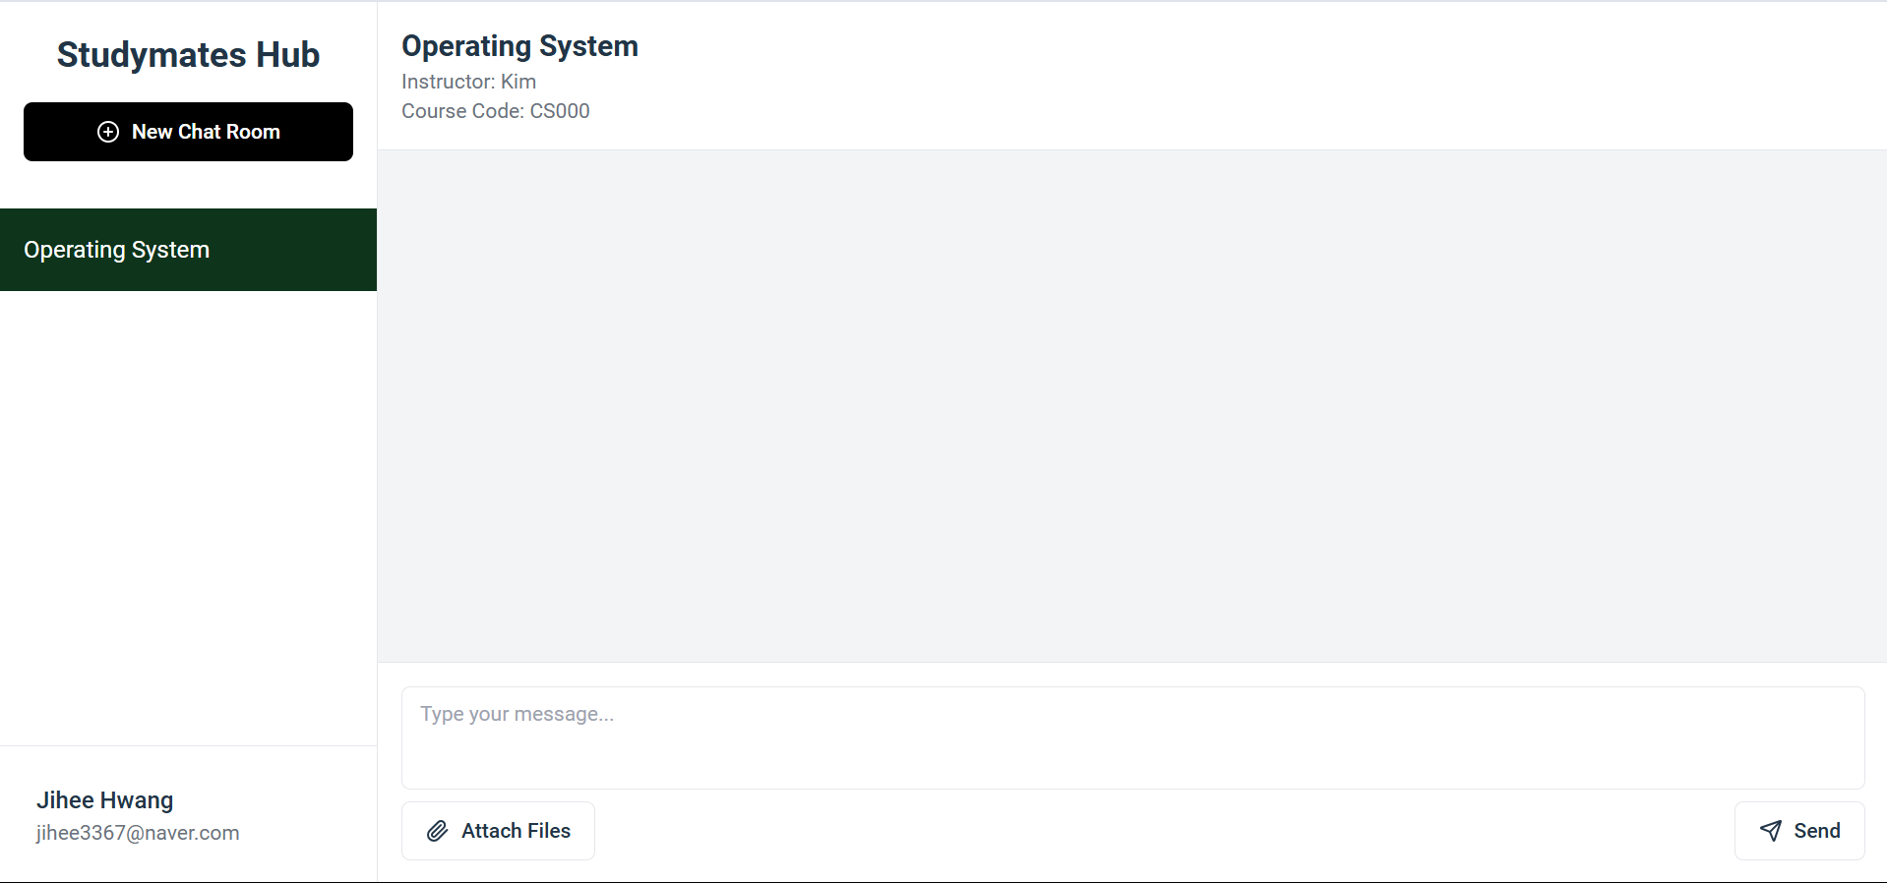
Implementations
UI/UX
the UI design was heavily inspired by ChatGPT, focusing on simplicity and user-centric interaction.
The chat interface automatically scrolls down based on the most recent message, ensuring users don’t need to manually scroll to view the latest conversation
Main Page

Slide 24
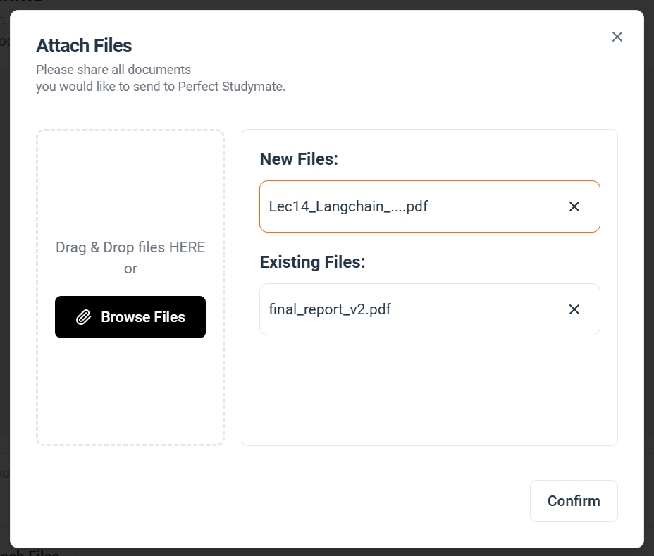
Implementations
UI/UX
supports both a button for file selection
and drag-and-drop functionality.
the interface visually distinguishes between new an
existing files, making it easy for users to differentiate
between previously uploaded files and new ones.
File Upload Dialog

Slide 25
Implementations
Frontend
Users can hover over the file name to instantly preview the content of their pdf files directly in the browser, improving convenience and ensuring that the correct file is selected before uploading.
Responsive design
File upload
preview
The frontend is integrated with a FastAPI backend using Axios to manage HTTP requests. A custom Axios instance was configured to handle API calls consistently, with proper setup for credentials and headers.
Code quality
management
API
integration
For authentication, the access token is stored in cookies, allowing automatic inclusion of authentication information in subsequent API requests.

Slide 26

Implementations
Backend
This approach ensures that processes such as fetching chat history, retrieving responses from the RAG model, and uploading pdf files can occur without blocking other operations.
JWT
Authentication
Asynchronous
The chatbot frequently requires retrieval of contextual data to generate accurate responses, which can be resource-intensive if queried directly from the database each time. By caching chat session data, the backend reduces the frequency of database queries, allowing session context to be retrieved directly from memory when available.
Caching chat session

Slide 27
Implementations
AI Modeling
Embedding manager
It prepares vector embeddings for course materials.
loads pdf files using PyPDFLoader and splits documents into chunks
(1000 characters with 200 overlaps) via RecursiveCharacterTextSplitter.
1
2
embeds and stores chunks in chroma vector database with metadata.
3
allows querying the vector database for similarity-based retrieval.
Through this step, the chatbot can generate answers based on course materials with relevancy.

Slide 28


Implementations
AI Modeling
Response generation
… To prevent this situation,
past conversations in the current chatrooms
are retrieved and inserted into the template querying to llm model
I'm allergic to carrots.
I see ☹
Please recommend me a lunch menu.
How about a carrot sandwich?
This allows a more natural conversation to take place by reflecting both the retrieved context and the interactive context.

Slide 29
Limitations
And… There are multiple limitations we cannot solve yet.
Implement an environment in which users can develop custom chatbots by uploading desired data.
Implement an environment in which users can develop custom chatbots by uploading desired data.
Implement an environment in which users can develop custom chatbots by uploading desired data.
Data embedding delay
Interpretability of image
Limitations of file extensions
If the user wants to use an extension file in the .docx or .pptx format for chatting, there is an inconvenience that the file must be converted to pdf by user before upload.
If an image data is included in pdf files, there is a limitation that these visual contents cannot be reflected in the response.
If a user uploads large pdf files on a chatroom, it may take a long time to embed the pdf files and store them in a DB.

Slide 30
Capstone Design Project
Thank you
For your attention
Team k
Juyong Rhee | Yewon Chun | Jihee Hwang | Jorge Alcorta

